Slide 1

Applied data science capstone
Jatin Selmokar

Slide 2
Business problem
A business client wishes to open a restaurant in the San Francisco area and has reached out for recommendations
Our objective is to build a clustering model on San Francisco neighborhood data to gain insights on the restaurant businesses and recommend best locations to the client

Slide 3
data
We will need
San Francisco neighborhood data
Geo-Coordinates for neighborhoods
Surrounding restaurant venues data for each neighborhood

Slide 4
METHODOLOGY
Extract neighborhood data using Beautiful Soup & Requests python packages
Populate geo-coordinates for neighborhood using Google Maps API
Get restaurant venues using Foursquare API
Use KMeans clustering to get clusters
Define each cluster

Slide 5
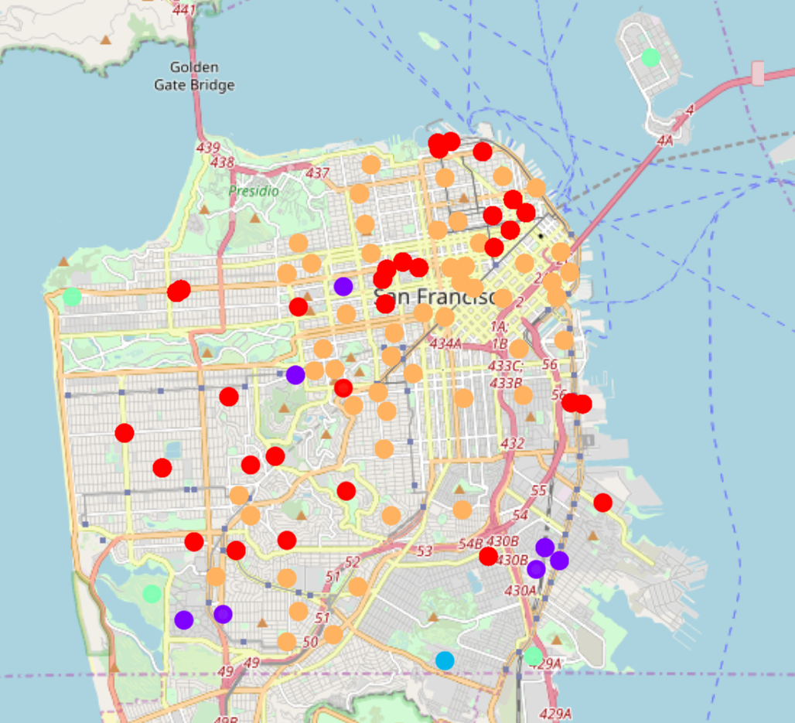
results
Cluster 1 (Red) – Japanese, Sushi, and Chinese restaurants
Cluster 2 (Purple) – Mexican & Southern/Soul restaurants
Cluster 3 (Blue) – Asian restaurants
Cluster 4 (Green) – American restaurants
Cluster 5 (Orange) – Vietnamese, Italian, and New American restaurants

Slide 6
discussion
Majority of the neighborhoods fall in the Orange cluster where Vietnamese, Italian, and New American are the popular cuisines
Wide variety of cuisines available throughout San Francisco
Asian food is popular in cluster 3 (Sunnydale area)

Slide 7
CONCLUSION
Based on client’s choice of cuisine, clusters can be studied to recommend locations
For instance, if the business owner had to open an Indian restaurant, neighborhoods in clusters 2,3, and 4 would be the ideal locations

